Slide 1


Test Automation

Slide 2
Objectives
Introduction To Test automation
Introduction To Web Pages
Introduction To Eclipse And Junit/TestNG
Objects Identification Locators
WebDriver Main Objects And Basic Actions
Synchronization
Verifications
Working With Multiple And Complexed Elements
Working With Multiple Windows And Frames

Slide 3
Objectives
Parameterize (Data Driven)
Running On Different Browsers
Selenium Grid (Remote and Parallel Execution)
Selenium IDE

Slide 4

Application lifecycle

Slide 5
Introduction To Test Automation
What Is Test Automation?
Test Automation Benefits
Test Automation Pre-Conditions
Which Test Cases To Automate?
Which Test Cases Not To Automate?
Test Automation Workflow
Test Automation Life Cycle
Test Automation Infrastructure
Test Automation Usage

Slide 6

What Is Test Automation?
The use of software to test software, by performing user actions and comparing actual to expected results
The use of software to test software, by performing user actions and comparing actual to expected results

Slide 7
Test Automation Benefits
Speed up the testing process
Fast execution paste (70% faster than the manual testing)
Unsupervised execution (night, lunch, branch)
Parallel execution
Reliable repetitive execution
Avoiding human errors (assuming of course there are no human errors in the automation development…)
Wider test coverage of application features
Increases Efficiency

Slide 8
Test Automation Pre-Conditions
Before we start a test automation project, we need to take few factors into consideration
Test plan
Knowledge of test scenario to be automated
ROI – Return On Investment (show me the money…)
Technical feasibility
Supporting automation tools
Tested technology
Application readiness

Slide 9
Which Test Cases To Automate?
Tests that need to run frequently
Every build and version
Sanity
Main business flows
Regression
Tests that require large number of verifications that is hard to achieve manually
DB
File's content
Tests that require detailed application information
GUI objects properties
Test that need to run with multiple sets of data (data driven tests)

Slide 10

Which Test Cases Not To Automate?
Too complicated (for development or execution)
One time testing
Ad hoc or with no predictable results
Usability testing
ASAP testing

Slide 11
Test Automation Workflow
01
Generate Script
Add Synchronization
02
03
Add Verifications
Enhance Script
04
05
Add Data Drive Script
Execute
06

Slide 12
Test Automation Lifecycle
HL Design
Unit Test
Integration Test
Execution
Maintenance
Scripts Creation
Detailed Design

Slide 13
Test Automation Lifecycle – HL Design
Test automation project is no different than any other development or testing projects. It requires a test plan (STP\HL design) that describes the project in high level:
Budget
Scope
Timetable
Resources
Tools
Environment requirements
Risks
Reports
HL Design

Slide 14
Test Automation Lifecycle – Detailed Design
In the detailed design document, we plan each automated test case in details:
Steps
Prerequisites
Initial and end conditions (Screen's state)
Script parameters
Data
Input data structure and content
Script dependencies
Input data from previous tests
Output data to next tests
Script algorithm
Division to functions
Detailed Design

Slide 15
Test Automation Lifecycle – Scrips Creation
In order to create solid reliable scripts our scripts should consist of the following:
Record or write your script
Add synchronization points
Add verification points
Data drive your script
Error handling mechanism
Reporting mechanism
Use
Coding standard
Existing function libraries
Reusable and maintainable code
Execute your script for success and failure conditions
Scripts Creation

Slide 16
Test Automation Lifecycle – Unit Test
Verify Script Execution:
Execute your script as many times as you can to verify stability:
Execute with success and failure conditions
Execute with different sets of data, positive and negative
Review report
Unit Test

Slide 17
Test Automation Lifecycle – Integration Test
Verify Test Suite Execution:
Execute your tests suite as many times as you can to verify stability:
The fact that a script ran successfully alone, doesn’t necessarily guarantees it will run successfully in a set
End condition of previous test doesn’t match initial condition of current test
Data transfer from previous test is wrong
Consider full execution time
Divide into subsets
Execute at night
Review full execution report
Integration Test

Slide 18
Test Automation Lifecycle – Execution
Preparations
Prepare application test environment
Prepare test automation execution
Set the Test
Configuration
Data
Execute
Analyze execution report
Open defects
Produce execution summary report
Execution

Slide 19
Test Automation Lifecycle – Maintenance
Maintenance means adjusting the package for next version.
It is doing the all-life cycle again.
Updating existing scripts with application changes
Flow changes
New objects
Identification changes in existing objects
Generate additional scripts
Maintenance

Slide 20

Test Automation Usage
Unit testing
Integration testing
Smoke testing
Sanity
Regression
Data driven testing

Slide 21
Test Automation – Shift Left
Shift left testing approach to software and system testing, means testing is performed earlier in the lifecycle

Slide 22




Selenium WebDriver
Selenium IDE
Selenium Grid
Distributing and running tests on several machines and manage multiple environments from a central point, making it easy to run the tests against a vast combination of browsers/OS
browser-based regression automation suites and tests
Chrome and Firefox add-on that will do simple record-and-playback of interactions with the browser

Slide 23
Introduction To Web Pages

Slide 24
Objectives
DOM
HTML
Elements - Classes And Objects
Methods (Actions)
Java Script
Properties
Get Values
Verify Values
CSS

Slide 25
DOM
DOM – Document Object Model
Describes the web page objects hierarchy, methods and properties
Allows programmers to access all the above information
HTML – Hyper Text Markup Language
Tag's language that is rendered by the browser to a visual web page
For example: text box <INPUT Type=text>, table <TABLE> etc.
How to access?
Manually
Browsers tools (E.g., Fire Bug, F12)
“View Source” menu option
Programmatically
Perform actions on objects
Get and verify object’s properties

Slide 26

DOM

Slide 27
DOM - Basic Page Structure
<html>
<head>
<style>
input
{
width: 40px;
}
.mandatoryInput
{
width: 40px;
color: Red;
}
</style>
<script>
function verifyValue(){
// Code here
}
</script>
</head>
CSS – Element's styling
Styling for all “Input” elements
Styling for all elements where class= mandatoryInput
Action after performing event on an element

Slide 28
DOM - Basic Page Structure
<body>
<div id=“div1”>
<div id=“div2”>
<input id="username" type="text“ class=mandatoryInput />
<input name="password" type="password“ onChange=verifyValue()/>
<input name=“OK" type=“button" value=“OK"/>
<a href=http://www.yahoo.com>Go to Yahoo</a>
</div>
</div>
</body>
</html>
Element type
Element’s attribute

Slide 29
Classes
Definition:
In object-oriented programming, a class is an extensible program-code-template for creating objects, providing initial values for state and implementations of behavior (member functions or methods)
Class is a code structure that gathers:
Properties: values that describes the class (E.g., Color, Position, Label and more)
Methods: operation the class can perform
Examples:
Class: Button
Properties: X, Y, Label, Width, Height
Methods: Click, Double Click
Class: Person
Properties: Height, Hair Color, Gender
Methods: Walk, Eat

Slide 30
Objects
Definition:
An object is an instance of a class
Objects inherits the class’s properties and methods and initializes the properties with values
Examples:
Object: OK Button (an instance of the Button class)
Properties: X = 10, Y = 10, Label = “OK”, Width = 100, Height = 20
Object: Sitvanit Har Dagan (an instance of the Person class)
Properties: Height = 160, Hair Color = “Brown”, Gender = “Female”
Object: Nachshon Ben Haaminadav (an instance of the Person class)
Properties: Height = 180, Hair Color = “Black”, Gender = “Male”
Automation Perspective:
Selenium identifies all HTML objects as WebElement

Slide 31
Methods
Definition:
Web page is event-driven. An action performed on an object (E.g., mouse\keyboard) invokes a method (action, function and more…) associated with this object’s event. For example, the Click event can invoke the default method OnClick or any other method associated by the programmer (E.g., verifyMandatoryFields)
The most common scripting language in web pages is Java Script
Automation Perspective:
Allows us to perform actions on HTML objects

Slide 32
Properties
Definition:
Properties describes objects by their values. E.g., Color, Position, Text, Value and more
Properties may affect objects behavior and available actions. E.g., Enabled, Focused, ReadOnly
CSS – Cascading Style Sheets
A language that is used to apply set of properties values on several objects or object types in a web page
Can be a section on a web page code or an external file
HTML tag: <style>
Automation Perspective:
Allows us to identify objects uniquely
Allows us to get and verify object’s properties

Slide 33
Exercise!

Slide 34
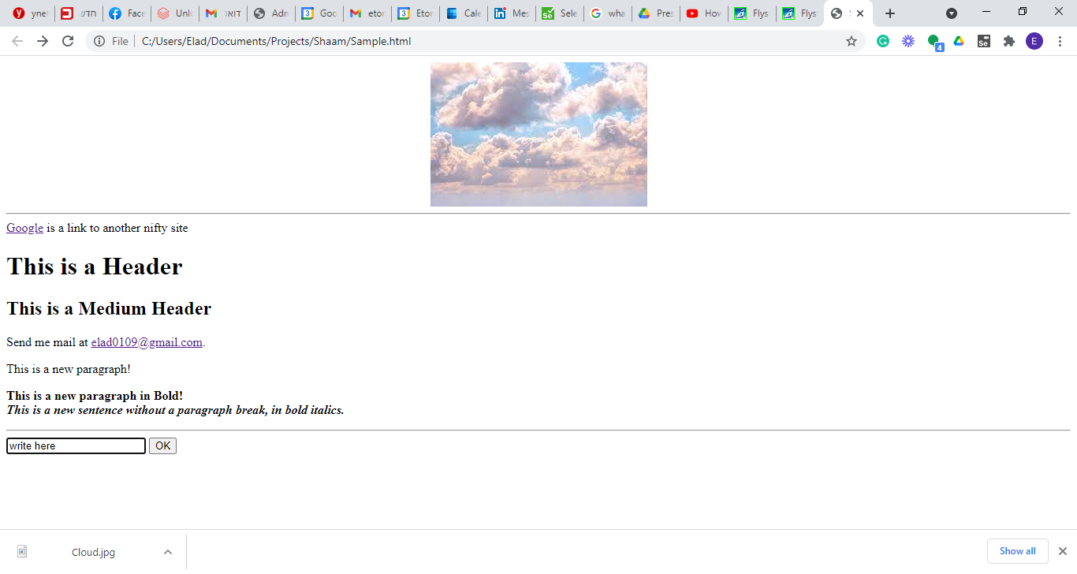

Slide 35
Selenium WebDriver – Java Essentials

Slide 36
Objectives
Variables
Data Types
Operators
Conditions
Loops
Classes
Functions
Java common functions

Slide 37
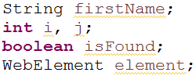
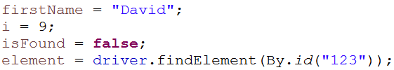
Variables
Variables are used to store values for later use.
They can be either public or private which determine their scope of recognition (mainly outside the class or only internal)
A variable has a data type that determines the data type that it will hold and instructs the OS when declared the memory required to hold this variable
Variable's declaration
Assignment

Slide 38
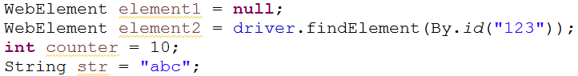
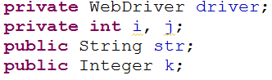
Variables
Declaration and assignment
Declaration with scope
Declaration as final value (can be assigned only once)

Slide 39
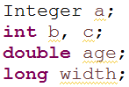
Data Types
Each variable has a data type which determines the data it can hold and the memory to allocate. Few examples:
Numbers
Strings
Classes\Objects

Slide 40
Data Types
Data Type | Size | Description
byte | 1 byte | Stores whole numbers from -128 to 127
short | 2 bytes | Stores whole numbers from -32,768 to 32,767
int | 4 bytes | Stores whole numbers from -2,147,483,648 to 2,147,483,647
long | 8 bytes | Stores whole numbers from -9,223,372,036,854,775,808 to 9,223,372,036,854,775,807
float | 4 bytes | Stores fractional numbers. Sufficient for storing 6 to 7 decimal digits
double | 8 bytes | Stores fractional numbers. Sufficient for storing 15 decimal digits
boolean | 1 bit | Stores true or false values
char | 2 bytes | Stores a single character/letter or ASCII values

Slide 41
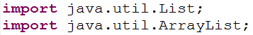
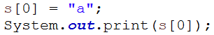
Arrays and ArrayLists
Arrays and lists holds multiple values
Import
Declaration and assignment
Accessing array elements

Slide 42
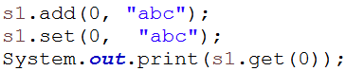
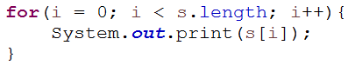
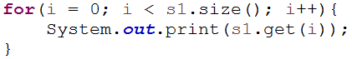
Arrays and ArrayLists
Accessing list elements
Iterating array
Iterating list

Slide 43
Arithmetic Operators
Operator | Description
+ | Addition
- | Subtraction
* | Multiplication
/ | Division
% | Modulo Operation (Remainder after division)
++ | Increment
-- | Decrement
++ and -- operator as prefix and postfix
If you use the ++ operator as a prefix like: ++var, the value of var is incremented by 1; then it returns the value.
If you use the ++ operator as a postfix like: var++, the original value of var is returned first; then var is incremented by 1.

Slide 44
Assignment Operators
Operator | Example | Same As
= | x = y
+= | x += y | x = x + y
-= | x -= y | x = x - y
*= | x *= y | x = x * y
/= | x /= y | x = x / y
%= | x %= y | x = x % y

Slide 45
Comparison And Logical Operators
Operator | Description
== | Equal value
!= | Not equal value
> | Greater than
< | Less than
>= | Greater than or equal to
<= | Less than or equal to

Slide 46
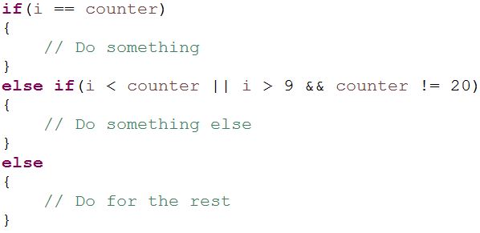
Conditions
We use conditions for decision making and branching in the code

Slide 47
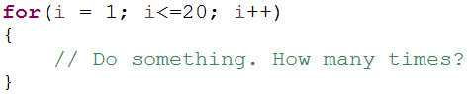
Loops
We use for loops to repeat a code part for predefined number of times

Slide 48
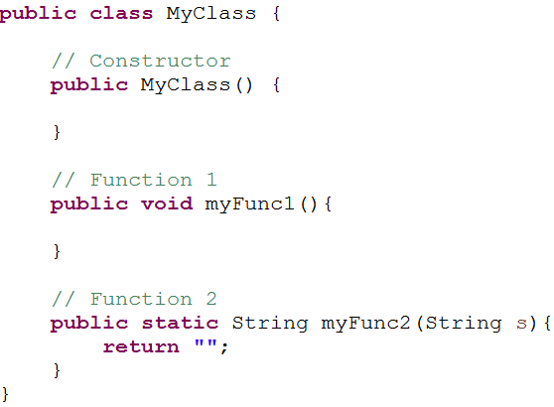
Classes
A class is a basic structure in OOP that consists of methods and properties
A class may have a constructor, which is a function named as the class and is executed when initiating a new instance of the class
Class declaration

Slide 49
Classes
Initiating an object from a class
Using a class method
Using a static method
Passing parameters and getting return value

Slide 50
Functions
A function is few commands grouped together under a name
Functions can accept arguments and return values
Functions benefits
Maintenance in one place
Reusability
Readability
Function declaration consists of
Scope – public\private
Return type – void\int\boolean\WebElement…
Function name
Function arguments types and names
A function can be declared as static – no object initiation is required to access the function

Slide 51
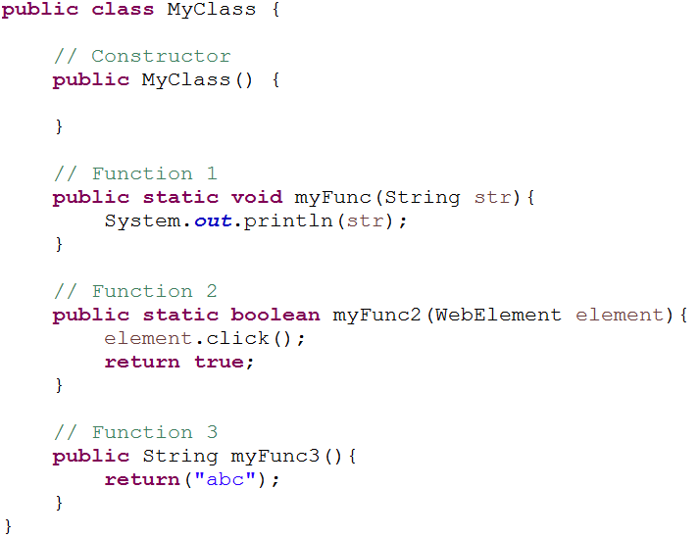
Functions - Examples

Slide 52
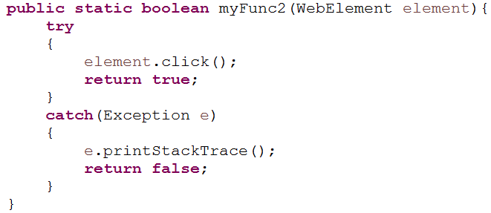
Functions - Basic Error Handling
Wrap your function code with a “try” to catch exceptions

Slide 53
Common String Functions
String functions are commonly used to perform manipulations on strings and to query strings
For the example below: String text = “Order 56 created”;
Function name | Function description | Example
indexof | Returns the index of the first occurrence of a specified text in a string. Starts from 0. | text.indexof(“created”)
lastindexof | Returns the index of the last occurrence of a specified text in a string | text.lastindexof(“created”)
split | Splits a string into an array by a specified delimiter | text.split(“ “)
replace | Replaces text in the string with new text | text.replace(“created”, “Created”)
substring | Returns a substring from index to index. Last index is not returned. | text.substring(6, 9)

Slide 54
Common String Functions
Function name | Function description | Example
toLowerCase | Returns the string in lower case | text.toLowerCase()
toUpperCase | Returns the string in upper case | text.toUpperCase()
concat | Joins few strings to one string | text.concat(“ successfully“);

Slide 55
Exercise!

Slide 56
Selenium WebDriver - Eclipse And JUnit Introduction

Slide 57
Work Environment Setup
Java Installations
Java JDK
Java JRE
Eclipse
Selenium Installations
Selenium Jar
IE Driver (exe) – if needed
Chrome Driver (exe)
Additional Jars
Optional, dependent on tasks

Slide 58
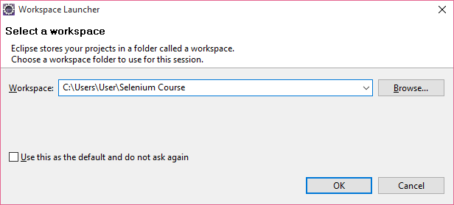
Eclipse Project - Workspace
Definition : The workspace is a directory on the disk where the Eclipse platform and all the installed plug-ins store preferences, configurations and temporary information
Start Eclipse
Set workspace name as “Selenium Course”

Slide 59
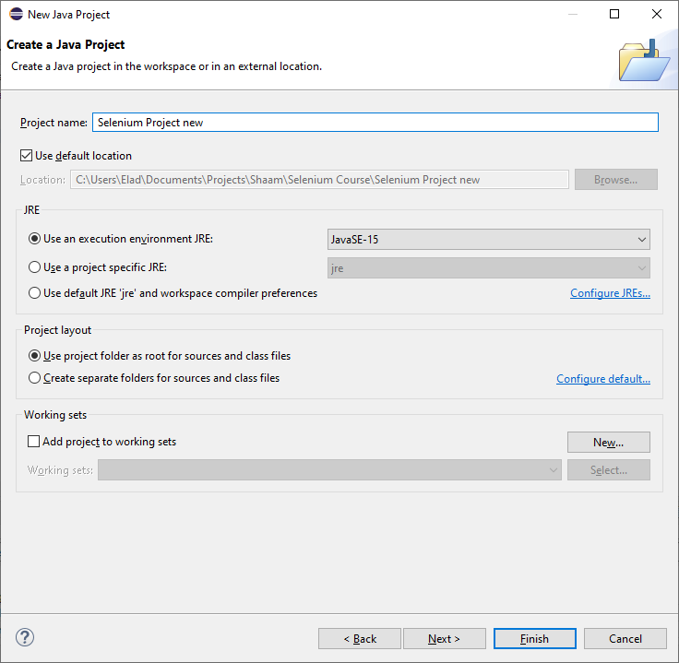
Eclipse Project – Create a Project
Definition : A project is a group of source files and the settings with which you build, run, and debug those source files. For applications that involve large code bases, it is often advantageous to split your application source code into several projects
Create a new project
File -> New -> Project
Select Java Project
Set name as “Selenium Project”
Press Next

Slide 60
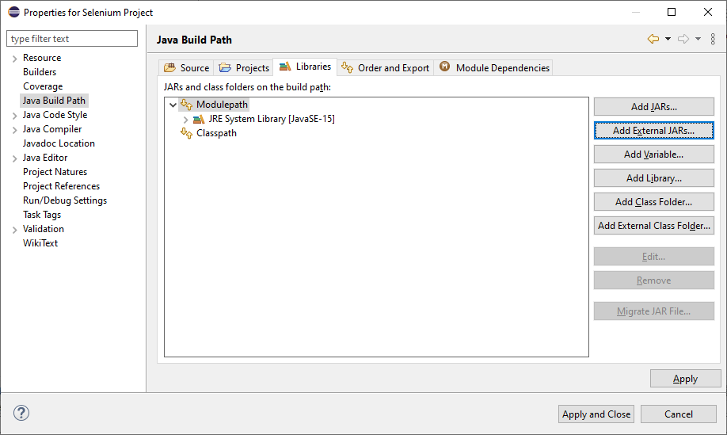
Eclipse Project – Add resources
Switch to Libraries tab
Press on Add External Jars
Navigate to selenium-java-4.0.0-beta-3 and select all in lib and all outside lib directory
Click Finish

Slide 61
Eclipse Project – Add resources
Switch to Libraries tab
Press on Add External Jars
Navigate to selenium-java-4.0.0-beta-3 and select all in lib and all outside lib directory
Click Finish

Slide 62
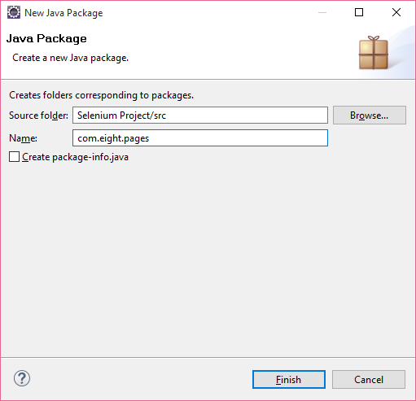
Eclipse Project – Package
Definition: Packages helps us to divide our project to logical areas
Create a new package:
Right click the folder you want top create the package under
Select “New -> Package”
Set its name (E.g., com.<anyname>.pages)
Click “Finish”

Slide 63
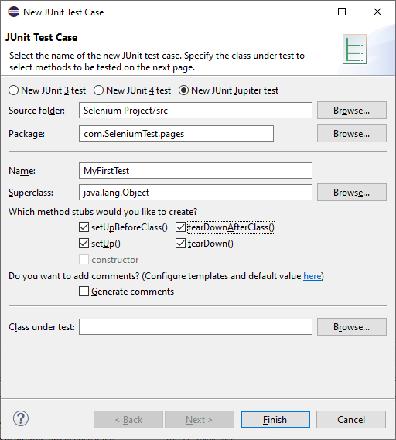
Eclipse Project – JUnit Test Case
Download and Install:
JUnit in Eclipse - junit-4.13.2.jar
hamcrest-core-1.3.jar
Right click package and select New -> Junit Test Case…
Set name as MyFirstTest
Check the “set” and “tear” 4 checkboxes
Click Finish

Slide 64
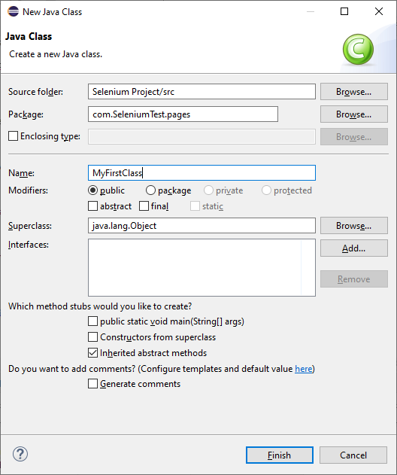
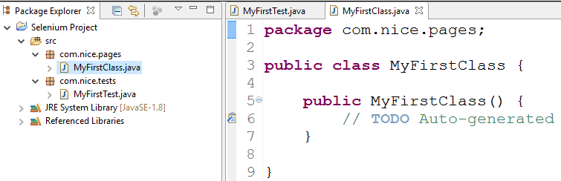
Eclipse Project – Class
To create a new class
Right click the package you want to create the class under
Select ”New -> Class”
Set its name. Start with a capital letter
Click “Finish”

Slide 65
JUnit Annotations
Annotations are a form of meta data, that the program behave by. In JUnit the annotations determine the order of the methods execution
JUnit annotations:
@BeforeClass – Will be executed before all the @Test annotations
Used for performing set up or general activities before executing the test suite (E.g. clean cookies, connect to DB)
@Before – Will be executed before each @Test annotation
Used for performing activities required before each test (E.g. Initializing WebDriver instance)
@After – Will be executed after each @Test annotation
Used for performing activities required after each test (E.g. Quitting WebDriver)
@AfterClass – Will be executed after all the @Test annotations
Used for performing activities required after test suite execution (E.g. clean cookies, disconnect from DB)

Slide 66
JUnit Annotations
Annotation | Description
@Test | Identifies a method as a test method.
@Disabled("reason") | Disables a test method with an option reason.
@BeforeEach | Executed before each test. Used to prepare the test environment, e.g., initialize the fields in the test class, configure the environment, etc.
@AfterEach | Executed after each test. Used to cleanup the test environment, e.g., delete temporary data, restore defaults, cleanup expensive memory structures.
@DisplayName("<Name>") | <Name> that will be displayed by the test runner. In contrast to method names the name can contain spaces to improve readability.
@RepeatedTest(<Number>) | Similar to @Test but repeats the test a <Number> of times
@BeforeAll | Annotates a method which is executed once, before the start of all tests. It is used to perform time intensive activities, for example, to connect to a database. Methods marked with this annotation need to be defined as static to work with JUnit.
@AfterAll | Annotates a method which is executed once, after all tests have been finished. It is used to perform clean-up activities, for example, to disconnect from a database. Methods annotated with this annotation need to be defined as static to work with JUnit.
@TestFactory | Annotates a method which is a Factory for creating dynamic tests
@Nested | Lets you nest inner test classes to force a certain execution order
@Tag("<TagName>") | Tags a test method, tests in JUnit 5 can be filtered by tag. E.g., run only tests tagged with "fast".
@ExtendWith | Lets you register an Extension class that adds functionality to the tests

Slide 67
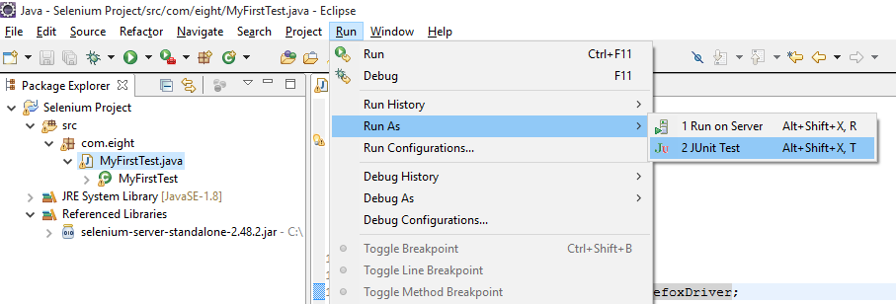
Eclipse Project – Running a Test
Select the test to execute
Using either right click or the “Run” menu, select Run As -> JUnit Test

Slide 68
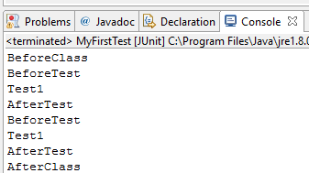
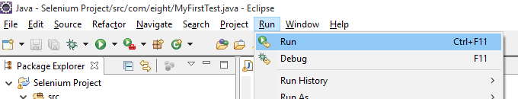
Eclipse Project – View Report
View the output in the “Console” tab at the bottom
Note that in the following runs, you can use the Run -> Run menu

Slide 69
Exercise!

Slide 70
Selenium WebDriver - Objects Identification

Slide 71
Objectives
What Is Object Identification?
Locators Types
How to Get The Object Identification?
findElement and findElements Methods

Slide 72
What Is Object Identification?
Selenium WebDriver is mainly used to test web pages. In order to do that, WebDriver must identify the different objects on the page in order to interact with them:
Perform actions
Verify properties
And more…

Slide 73
Locators Types
Selenium can identify objects by different locator methods:
Object's properties
ID
Name
Link (Full or partial text)
XPath
HTML Tag Name
Class Name (CSS)

Slide 74
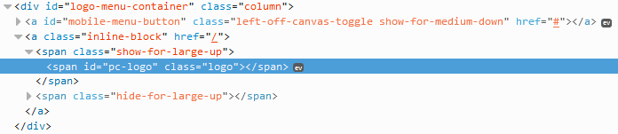
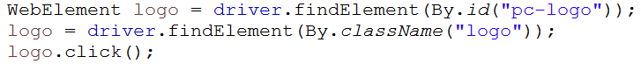
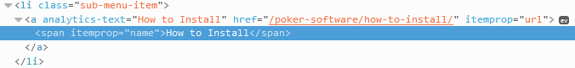
Object Properties

Slide 75
Xpath
XPath (short for XML Path) is a mechanism to locate objects using the DOM objects hierarchy and objects properties
Don’t use the XPath automatically. It may be too generic and easily affected by page structure changes
Use short relative XPath
Combine properties values, don’t rely on structure only
Tool to find Xpath - SELECTORSHUB
Pros
Easy to match 1 object
Cons
May be influenced by page hierarchy changes

Slide 76
Xpath basic syntax
Example | Description | Syntax
//div[1] – First “div” element in page | From document root | //
//div[1]/a – “A” element directly under the first “div” in page | Directly under element | /
//div[1]//a – “A” element anywhere under the first “div” in page | Anywhere under element | //
– “div” element by ID //div[@id=‘logo-menu-container’] | By attribute | @
//div[text()=‘Bluh bluh’] – “div” element by it’s text | By text | text()
.//input – All “input” elements under current element | Current element | .
..//input - All “input” elements under current element parent | Parent element | ..

Slide 77
Xpath
XPath Tutorial: https://www.guru99.com/xpath-selenium.html

Slide 78
CSS
CSS (Cascading Style Sheets) is another mechanism to locate objects using the DOM objects hierarchy and objects properties
Don’t use the CSS automatically. It may be too generic and easily affected by page structure changes
Use short relative CSS
Combine properties values, don’t rely on structure only
Pros
Easy to match 1 object
Faster than XPath
Cons
May be influenced by page hierarchy changes

Slide 79
CSS basic syntax
Example | Description | Syntax
.inline-block – Element with class = inline-block a.inline-block – “A” element with class = inline-block | Class | .
#logo – Element with id = logo Img#logo – “img” element with id = logo | id | #
a[class=inline-block] – “A” Element with class = inline-block | By attribute
div a[class=inline-block] – “div” with “a” anywhere under it | Anywhere under element | <space>
div > a[class=inline-block] – “div” with “a” directly under it | Directly under element | >
A[id*=“abc”] – “A” element with id containing “abc” | Contains | *
A[id^=“abc”] – “A” element with id starting with “abc” | Starts with | ^

Slide 80
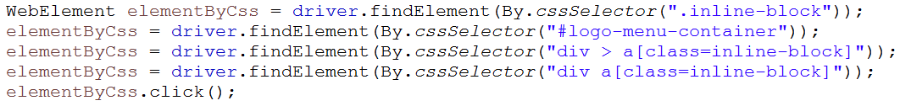
CSS
CSS Tutorial: https://www.w3schools.com/cssref/css_selectors.asp

Slide 81
Tag Name
Locating the object by it’s element name
Find Element command returns the web element that matches the first most element within the web page.
Find Elements command returns a list of web elements that match the criteria.
Pros
Easily get a group of objects
Why do we want to get a group of objects?
Perform the same action on few objects
Get data from few objects
Cons
May match more than one object

Slide 82
Tag Name

Slide 83
Class Name
Locating the object by its element name
Find Element command returns the web element that matches the first most element within the web page.
Find Elements command returns a list of web elements that match the criteria
Pros
Easily get a group of objects
Cons
May match more than one object

Slide 84
Class Name

Slide 85
How To Get The Object Identification?
Use recorded identification (Selenium IDE, Tools over Eclipse)
Use a spying tool (E.g. SELECTORSHUB, F12)
View page source

Slide 86
How to install and use SELECTORSHUB?
1. After installing SelectorsHub Chrome extension, restart the browser.
2. Open DevTools by pressing F12 or Right-click anywhere on the webpage.
3. Click on Inspect.
4. On right side of Elements tab, click on SelectorsHub tab. It will be the last tab, if not visible then expand sidebar.
5. If auto suggest doesn't work while building Selectors,
6. Open different website in new tab.

Slide 87
Find single Element
Use when expecting 1 element
If element is not found, an error is thrown
Returns a WebElement object

Slide 88
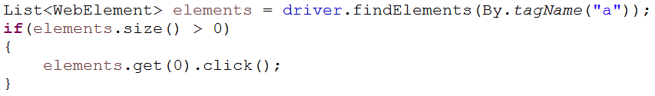
Find Elements
Use when expecting few elements or to avoid a runtime error if element is not found
If elements are not found, no error is thrown. The list size will be 0.
Returns a WebElement objects list

Slide 89
Exercise!

Slide 90
Selenium WebDriver - Basic Actions

Slide 91
Objectives
WebDriver Class
WebElement Class

Slide 92
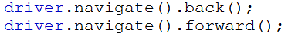
WebDriver Class
WebDriver is the class that enables interaction with the browser
To include in your test:
Initiate WebDriver Object From WebDriver Class:
It’s main methods are:
Navigate to a web page:
The navigate interface enables us more navigation options such as:

Slide 93
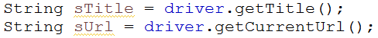
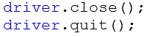
WebDriver Class
Get information from the web page:
Locating a web element:
Ending a session:
Close – Closing the current browser
Quit – Closing all browsers and ending the WebDriver session

Slide 94
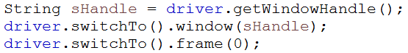
WebDriver Class
Changing window or frame focus:

Slide 95
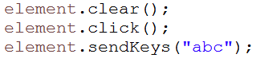
WebElement Class
WebElement is the class that enables interaction with web elements
To include in your test:
Initiate WebElement Object From WebElement Class:
Actions on web element:

Slide 96
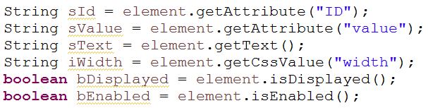
WebElement Class
Getting data from web element:

Slide 97
Exercise!

Slide 98
Selenium WebDriver Synchronization

Slide 99
Objectives
What is a synchronization point?
Implicit Wait
Explicit Wait
Just Wait…

Slide 100
What is synchronization point?
Synchronization point is a command that synchronizes the execution paste to the application paste, by waiting for some condition to be met:
Wait for page to load
Wait for page title
Wait for object text
Wait for object appearance
Wait for a popup message
And more…

Slide 101
Implicit Wait
Implicit wait is a general, one time command that tells the driver how long to wait for:
Page to load
findElement
findElements
Usage:

Slide 102
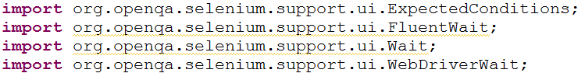
Explicit Wait
Explicit wait is used when waiting for a specific object condition to be met:
Object to be visible
Object to be clickable
Object to contain specific text
Selection from a list loads values in another list
Wait for dynamic data call (Ajax, Jason, etc.)
Note that some explicit waits throws an error if element is not located, and some doesn’t
Usage:

Slide 103
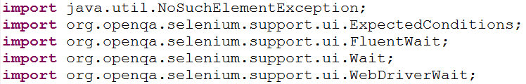
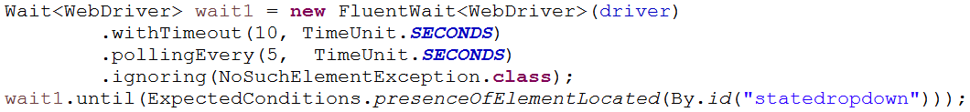
Explicit Wait - FluentWait
FluentWait adds the following options to Wait:
Interval between condition checks
Ignore error when object is not found
Usage:

Slide 104
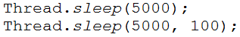
Just Wait
Wait for a certain amount of time (no condition to be met)
When to use?
When no conditional wait is available
Interval between loop iterations
Usage:

Slide 105

Common Synchronization Commands
Wait for object’s to be visible
What is the difference between the above waits?

Slide 106
Common Synchronization Commands
Wait for object’s to be nonvisible
Invisibility condition doesn’t fail the test if element is not found
Wait for object to be clickable
Wait for element text
Element selection

Slide 107
Common Synchronization Commands
Page synchronization
Frame synchronization
Alert (popup)

Slide 108
Exercise!

Slide 109
Selenium WebDriver Verifications

Slide 110
Objectives
What is an assertion?
What can be verified?
Inserting an assertion
Assert Highlights
Viewing assertion result
Retrieving Element Data
Common assertion
Custom verifications

Slide 111
What Is an Assertion?
In Selenium verification points are called “Assertion”
Assertion is a line of code that verifies actual value against expected value, and reports the result to the execution report

Slide 112
What Can Be Verified?
Well… in general, if it can be programmed, it can be verified. That means basically everything…
GUI objects
GUI objects properties values
Object existence
Page title and URL
And more…
DB
File's existence and data
Web services

Slide 113
What are the steps for Inserting Assertions?
Decide what to verify and where to locate the “Assert” command
Get the actual value from the application
Use the relevant “Assert” command to compare the actual value to the expected one
Expected value can be retrieved from:
Another application element
External data driving source (E.g. XML, Excel etc.)
Hard coded
Execute your test and view results in the JUnit console

Slide 114
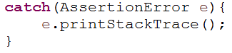
Assert Highlights
Failing assertion result in error (and not Exception) throwing and is stopping the test
It is NOT going into the “catch” part
To continue the test run after assert:
Catch the error
Write your own verification point instead

Slide 115
Assert Highlights
In which cases would you like the assertion to stop execution?
Where the error prevents the flow to continue, E.g., expected page didn’t load, a button is disabled
In which cases wouldn't you like the assertion to stop execution?
Where the error doesn’t prevent the flow to continue, E.g., verifying element property which is not relevant for the business flow (color, size etc.)

Slide 116
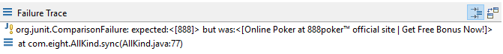
Viewing Assertion Result
Assert result will be shown in the JUnit console
Success will not give any indication
Failure

Slide 117
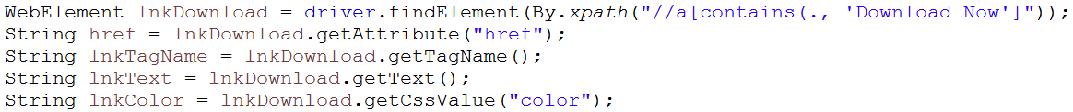
Retrieving Elements Data
In order to verify page or element, we first need to retrieve the actual value from the page or the element
Page “get” functions
Element “get” functions
Note that “getText” will retrieve the text from elements with open and close tags such as “div”, “a” etc.
To retrieve a text box value use

Slide 118
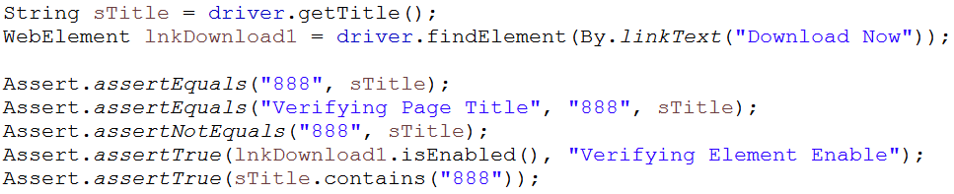
Common Assertions
Assert Equal – Accepts 2 values and compares them. If not equal – Fail
Assert Not Equal - Accepts 2 values and compares them. If equal – Fail
Assert True – Accepts 1 value. If false – Fail

Slide 119
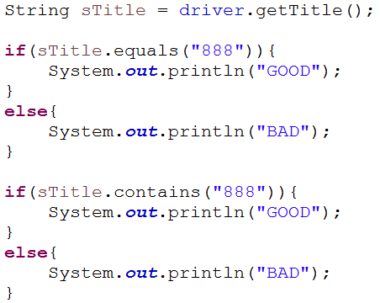
Custom Verification
You can write your own verifications to avoid the Assertions limitations, by using Java conditioning

Slide 120
Exercise!

Slide 121
Working With Multiple Elements

Slide 122
Objectives
When To Use
Retrieving a List of Elements
Iterating List Of Elements
Handling Few Elements as an Object
The “TABLE” Element
The “SELECT” Element
And More…

Slide 123
When To Use
We may want to retrieve a group of element to perform a task
Verify a property of all elements (E.g., Button's font, Text fields size etc.)
Perform an action or get data from an “object” which is built from few elements
List
Table

Slide 124
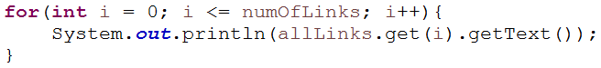
Retrieving a List of Elements
Import
Get elements
Accessing a list item
Getting the size of the element list
Iterating through Java list

Slide 125
Handling Few Elements as an Object
Sometimes we would like to treat few elements as one objects, in order to perform the required action
Get data from a TABLE
Build a flexible function to handle a custom menu
Verify items in a combo box
And more…

Slide 126
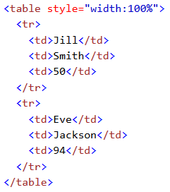
Table Elements
TABLE consists mainly of 3 tags
TABLE
TR (row)
TD (cell)

Slide 127
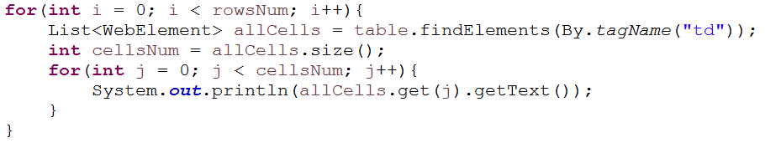
Get Table Elements
Get number of rows
Iterating rows and cells

Slide 128
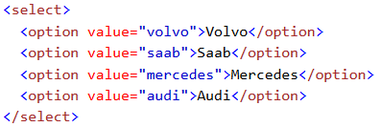
Select Element
SELECT consists mainly of 2 tags
SELECT
OPTION

Slide 129

Select Element
For SELECT there is already a solution
Import
Initiate object
Select list item

Slide 130
Exercise!

Slide 131
Selenium Web Driver – Parameterize

Slide 132
Objectives
What is parameterization (AKA DDT, KDT)?
Parameterization benefits
Parameters resources
Parameterization Process
Parameterize output data – Store to variable

Slide 133
What Is Parameterization?
parameterization is replacing hard coded values in your script with values from external source
The external source can contain the input data only (Data Driven Test) or includes the functions to execute as well, and thus you can create the actual flow in the external resource (Key Driven Test)

Slide 134
Parameterization Benefits
Parameterization enables us
Run same test in a loop
Run the same test with different sets of data
Using external data files
Control the test flow from external file
Move data between steps and tests
Write back to the external file for later use
Control environment general data from external file
URL
User details
DB details
And more…

Slide 135
Parameterization Benefits
Parameterization enables us
Run same test in a loop
Run the same test with different sets of data
Using external data files
Control the test flow from external file
Move data between steps and tests
Write back to the external file for later use
Control environment general data from external file
URL
User details
DB details
And more…

Slide 136

Parameterization Process – Properties File
Create properties file
Right click on your project root
Select “New -> File”
Set it’s name (E.g. env.properties) and
click “Finish”
Write pairs of names and values:
URL = https://www.google.com
UserName = Keren
Etc…

Slide 137


Parameterization Process – Reading Properties File
Import
Initiate the relevant objects
Load the file data into the “Properties” object
Retrieve parameter value
Use the data

Slide 138

Parameterization Process – XML File
Create XML file
Right click on your project root
Select “New -> Other -> XML -> XML File”
Set it’s name (E.g. Sanity)
click “Finish”
Set rows of data:

Slide 139


Parameterization Process – XML File
Import
Initiate the relevant objects
Load the file data into the “Document” object

Slide 140
Parameterization Process – reading XML File
Retrieve parameter value
Use the data

Slide 141


Parameterization Process – Iterating XML File
Import
Retrieve multiple nodes
Iterate nodes and retrieve it’s text and attributes value

Slide 142

Parameterization Process – Excel File
Create Excel file and locate it in the file system
Set headers and populate rows
Add external JARs to your project:
poi-3.10-FINAL-20140208.jar
poi-ooxml-3.10-FINAL-20140208.jar
poi-ooxml-schemas-3.10-FINAL-20140208.jar
xmlbeans-2.3.0.jar
dom4j-1.6.1.jar

Slide 143

Parameterization Process – Reading Excel File
Import
Load Excel file
Get sheet
Get cell value

Slide 144

Parameterization Process – Iterating Excel File
Iterate rows

Slide 145

Parameterization Process – Writing to Excel File

Slide 146
Exercise!

Slide 147
Managing Test Objects

Slide 148
Objectives
Why test objects needs to be managed?
Ways to manage test objects
External file
Properties file
XML file
Page object design pattern

Slide 149
Why test objects needs to be managed?
When using web elements in our tests we use various types of locators, which uses DOM hierarchy and elements properties to uniquely identify the elements
We may need to change element locator in case our locator is no longer valid in a new version. That can happen due to hierarchy or properties values changes

Slide 150
Ways to manage test objects
In order to keep those changes centralized, it is a common practice to have the elements description (locators) in one place. That place can be:
An external file (referred to as GUI Map \UI-Element File\Objects Repository)
A centralized place or structure in the code
By doing the above we gain:
Maintainability – fast maintenance in one place
Reusability – element needs to be learned one time and then reused
Readability – a much readable code by using a logical, friendly name for the elements

Slide 151
External File
The external file can be of various types
XML
Properties file (text)
Each element will consist of:
Logical name – a meaningful name that we give the element
Used for locating the object in the file from the Java code
Physical description
The actual description (locator) of the object in the web page
Can include also a parent page description:
To make the file modular and easy to manage
Can be used to verify we are at the correct page before interacting with the elements

Slide 152

External File - Properties
The structure of the file should be:
Easy to manage
Easy to parse
A code should be written to retrieve and parse the data and search for the element in the page
File examples:

Slide 153


External File - Reading Properties File
Import
Initiate the relevant objects
Load the file data into the “Properties” object
Retrieve parameter value

Slide 154

UI Properties File – Function Example

Slide 155

UI Properties File – Function Example

Slide 156

UI Properties File – Function Example

Slide 157

UI Properties File – Function Example

Slide 158
External file - XML
The structure of the file should be:
Easy to manage
Easy to parse
A code should be written to retrieve and parse the data and search for the element in the page

Slide 159


External file - Reading XML File
Import
Initiate the relevant objects
Load the file data into the “Document” object

Slide 160
External file - Reading XML File
Retrieve parameter value

Slide 161

UI XML File – Example

Slide 162

UI XML File – Example

Slide 163

UI XML File – Function Example

Slide 164

UI XML File – Function Example

Slide 165

UI XML File – Function Example

Slide 166

UI XML File – Function Example

Slide 167

UI XML File – Function Example

Slide 168
Page Object Pattern Design
A common way to handle web pages and elements locators is “Page Object Design Pattern”
Advantages
Manage all page functionality and elements in one place
It’s main features
A Java class per web page
Initializing all page elements in the class constructor or top
The class includes all the page test functions
Functions that navigates away from the page, returns the next page object

Slide 169

Page Object Pattern Design – New Class
To start a new class
Right click your package and select “New -> Class”
Enter name and check “Constructors from superclass”
Press “Finish”

Slide 170
Page Object Pattern Design – 1st Method
Declare objects description
By logoImage = By.id("logo");
By links = By.tagName("a");
By firstLink = By.tagName("a");
Use elements
Driver. findElement(logoImage).click()
Return next Page Object
return new YahooSearch(driver)

Slide 171

Page Object Pattern Design – Page Objects Example

Slide 172

Page Object Pattern Design – Page Objects Example

Slide 173

Page Object Pattern Design – Page Objects Example

Slide 174

Page Object Pattern Design – Page Objects Example

Slide 175
Exercise!

Slide 176
Multiple Windows And Frames

Slide 177
Objectives
Multiple Windows
Multiple Frames

Slide 178


Multiple Windows
Selenium WebDriver can connect to a single window at a given moment, so when an action in a page opens an additional page, we need to explicitly move between the windows in order to perform actions on its elements
Import
Switch to new window

Slide 179
Multiple Windows
Switch back to main window
driver.switchTo().window(parent);

Slide 180
Multiple Frames
When we want to access elements in a frame in a page, we must first move the driver control to the frame
We can switch to frame by 3 ways
By index
By name
By WebElement

Slide 181
Multiple Frames
Switch back to main window
Or

Slide 182
Exercise!

Slide 183
Selenium IDE

Slide 184
Objectives
Selenium IDE (Integrated Development Environment) is primarily a record/run tool that a test case developer uses to develop Selenium Test cases.
Provides you the capability of automatically recording your test cases based upon the interactions with the browser
Developer can run the entire test suite consisting of multiple test cases or execute a single test case
Run Selenese commands, which helps the IDE understand what needs to be done
Allows the test developers to set breakpoints for the purpose of debugging particular test cases
Test cases can be re-used using the run command.
Use of multiple-locators for each element in the IDE.

Slide 185
Limitations of Selenium IDE
Not suitable for testing extensive data
Connections with the database can not be tested
Cannot handle the dynamic part of web-based applications
Does not support capturing of screenshots on test failures
No feature available for generating result reports

Slide 186
Recording your first test
After creating a new project, you will be prompted to name it and then asked to provide a base URL. The base URL is the URL of the application you are testing. It's something you set once, and it gets used across all of the tests in this project. You can change it later if need-be.
After completing these settings, a new browser window will open, load the base URL, and start recording.
Interact with the page and each of your actions will be recorded in the IDE. To stop recording, switch to the IDE window and click the recording icon.

Slide 187
Organizing your tests – Add a test
You can add a new test by clicking the + symbol at the top of left side-bar menu (to the right of the Tests heading), naming it, and clicking ADD.
Once added you can either input commands manually or click the record icon in the top-right of the IDE.

Slide 188
Organizing your tests – Suites
Tests can be grouped together into suites.
On project creation, a Default Suite gets created and your first test gets added to it automatically.
To create and manage suites go to the Test suites panel. You can get there by clicking the drop-down at the top of the left side-bar menu (e.g., click on the word Tests) and selecting Test suites.
Add a suite
To add a suite, click the + symbol at the top of the left side-bar menu to the right of the Test Suites heading, provide a name, and click ADD.

Slide 189
Organizing your tests – Suites
Add a test
To add a test to a suite hover over the suite name, then do the following:
Click on the icon that appears to the right of the Test Suites heading
Click Add tests
Select the tests you want to add from the menu
Click Select
Remove a test
To remove a test, hover your mouse over the test and click the X that appears to the right of the name.
Remove or rename a suite
To remove a suite, click the icon that appears to the right of its name, click Delete, and click Delete again when prompted.
To rename a suite hover over the suite name, click the icon that appears to the right of the name, click Rename, update the name, and click RENAME.

Slide 190
Playback
You can play tests back in the IDE by selecting the test or suite you'd like to play and clicking the play button in the menu bar above the test editor.
The test(s) will play back in the browser. If a window is still open from recording, it will be used for playback. Otherwise, a new window will be opened and used.

Slide 191

Adding new command

Slide 192
Exercise!

Slide 193
Remote Execution

Slide 194
Objectives
Benefits Of Remote Execution
Remote Web Driver
Setting remote execution machines
Setting test for Remote Execution
Selenium Grid
Setting Hub
Setting Nodes
Setting test for Remote Execution Using Grid
Desired Capabilities

Slide 195

Selenium GRID

Slide 196
Benefits Of Remote Execution
Running on different combinations of Device\OS\Browser
Running from different locations
Parallel execution

Slide 197

Start Hub
Hub is the central point in the Selenium Grid that routes the JSON test commands to the nodes. It receives test requests from the client and routes them to required nodes. To set up the Selenium Hub, open command prompt, and navigate to the directory where the Selenium Server Standalone jar file is stored
Current Version - selenium-server-standalone-3.141.59.jar
Type the following command :
java -jar selenium-server-standalone-<version>.jar -role hub

Slide 198
Setting a node
On the node machine
From command line run: java –jar <path to the Jar file> -role node –hub http://<hub ip>:4444/grid/register
For each node you can define the available browsers to use and other parameters
The hub will later use it to determine on which machine to run
From command line run: java –jar <path to the Jar file> -role node –hub http://<hub ip>:4444/grid/register –browser browserName=firefox –browser browserName=chrome
You can define more specific details while setting a node
E.g. –browser browserName=firefox,version=3.6,platform=LINUX
You can also define the Desired Capabilities later on from your code

Slide 199

Setting a node
You can view the hub and registered machine on http://localhost:4444/grid/console

Slide 200


Selenium Grid - Execution
To execute your test through the hub
Import
Invoke the required browser on the remote machine through the hub (The URL should contain the hub’s IP)
The hub will launch the execution on one of the remote nodes by the desired capabilities definitions

Slide 201
Selenium Grid – Desired Capabilities
Desired Capabilities let us define some environment and behavior parameters of our execution
such as:
platform – Win10\Linux etc
browserName - firefox\chrome\IE etc
version – Browser version
maxInstances - Maximum number of instances to allow to connect to grid

Slide 202


Selenium Grid – Desired Capabilities

Slide 203
Exercise?

Slide 204
Postman

Slide 205
Objectives
What is Postman
Download Postman
Send Request
Analyze the Response
JavaScript test

Slide 206

What is Postman?
Postman is a popular API client for testing APIs by allowing users to create and save simple and complex HTTP requests as well as read their responses.
Postman offers a simple user-friendly interface.
Postman allows creating individual JavaScript test scripts.

Slide 207

Send a request

Slide 208
Send a request – Test site
Postman Echo is service you can use to test your REST clients and make sample API calls. It provides endpoints for GET, POST, PUT, various auth mechanisms and other utility endpoints.
The documentation for the endpoints as well as example responses can be found at:
https://postman-echo.com

Slide 209
Request Method
HTTP has multiple request "verbs", such as GET, PUT, POST, DELETE, PATCH, HEAD, etc.
An HTTP Method (verb) defines how a request should be interpreted by a server. The endpoints in this section demonstrate various HTTP Verbs. Postman supports all the HTTP Verbs, including some rarely used ones, such as PROPFIND, UNLINK, etc.
For details about HTTP Verbs, refer to RFC 2616
http://www.w3.org/Protocols/rfc2616/rfc2616-sec9.html#sec9

Slide 210
GET Request
The HTTP GET request method is meant to retrieve data from a server. The data is identified by a unique URI (Uniform Resource Identifier).
A GET request can pass parameters to the server using "Query String Parameters". For example, in the following request,
https://postman-echo.com/get?id=1&type=vip
The parameter “id" has the value “1“ and the parameter “type" has the value “vip“

Slide 211

GET Response
The Postman Body tab gives you several tools to help you understand the response quickly. You can view the body in one of three views - pretty, raw, and preview.

Slide 212

Scripting in Postman
Postman contains a powerful runtime based on Node.js that allows you to add dynamic behavior to requests and collections. This allows you to write test suites, build requests that can contain dynamic parameters, pass data between requests, and a lot more. You can add JavaScript code to execute during 2 events in the flow:
Before a request is sent to the server, as a pre-request script under the Pre-request Script tab.
After a response is received, as a test script under the Tests tab.

Slide 213

Execution order of scripts
In Postman, the script execution order for a single request looks like this:
A pre-request script associated with a request will execute before the request is sent
A test script associated with a request will execute after the request is sent

Slide 214

Test Result

Slide 215
Exercise

Slide 216
Execution order of scripts
Send the following GET request:
https://restcountries.eu/rest/v2/alpha/nor
• Use JavaScript tests to verify the following in the
response:
Verify that the returned response was 200OK
Verify that the Content-Type contains ‘application/json’
Verify that the country name is ‘Norway’

Slide 217
Introduction to REST

Slide 218
Objectives
What is REST?
REST Request
REST Response
Authentication
Exercise

Slide 219
What is REST?
REST = REpresentational State Transfer
REST is a set of rules for communicating between a client and a server
It is an architectural style that defines a way to Make uniform API calls through RESTful web service interface

Slide 220
REST request
Endpoint - the request URL -> http://official-jokeapi.appspot.com/
Method -> the type of request you send to the server: GET/HEAD/POST/PUT/DELETE/PATCH
Headers - provide information to both client and server
Body - contains the data to send to the server

Slide 221
Endpoint structure
Root endpoint - the basic url (like any other website): https://official-joke-api.appspot.com
Path - Determines the resource that is called:Example: /random_joke, /random_ten, /jokes/programming/random
In order to understand the available paths, we need to look into the API‘s documentation: https://github.com/15Dkatz/official_joke_api

Slide 222
Methods - GET
Used to retrieve resource representation/information only and not to modify it in any way.
It is considered a safe method.
If the resource found on the server, then it must return HTTP response code 200 (OK) along with the response body.
If the resource is not found on the server it must return HTTP response 404 (NOT FOUND)

Slide 223

Methods - HEAD
HEAD - is used to request headers from the server.
It is identical to the GET method except that the server must not return the message body in the response.

Slide 224

Methods - Post
POST methods are used to create a new resource into the collection of resources.
Not considered a safe method.
If a resource has been created on the origin server, the response SHOULD be HTTP response code 201 (Created) and contain an entity which describe the status of the request.
Many times, the action preformed by POST method might not result in a resource that can be identified by the URI. In this case either HTTP response code 200 (OK) or 204 (No Content) is the appropriate status.

Slide 225
Methods - PUT
PUT is used primarily to update existing resource. If the resource does not exist, the server can create a new resource
If a new resource has been created the origin server MUST send HTTP response code 201 (Created). If an existing resource is modified either 200(OK) or 204(No Content) response codes SHOULD be sent.

Slide 226
Methods - PATCH
PATCH is used to make partial update on a resource.
Not all the browsers support PATCH.

Slide 227
Methods - Delete
DELETE is used to delete resources.
A successful response to DELETE request SHOULD be HTTP response code 200 (OK) if the response include an entity describing the status. 202 (Accepted) if the action has been queued or 204 (No Content) if the action has been performed but the response does not include any entity.
Example: HTTP DELETE http://www.appdomain.com/users/123

Slide 228
REST - Headers
DELETE is used to delete resources.
A successful response to DELETE request SHOULD be HTTP response code 200 (OK) if the response include an entity describing the status. 202 (Accepted) if the action has been queued or 204 (No Content) if the action has been performed but the response does not include any entity.
Example: HTTP DELETE http://www.appdomain.com/users/123

Slide 229
REST - Data
Contains information you want to send to the server.
Used only with POST, PUT, PATCH or DELETE requests.
Sometimes referred to as ’body‘ or ’message‘
Large variety of possible content types. Example -
application- json, xml, javascript, audio, image, video, text and more.
{
"Id": 12345,
"Customer": "John Smith",
"Quantity": 1,
"Price": 10.00
}

Slide 230
HTTP Response
Status codes and error messages:
2xx (ex - 200, 201) means the request has succeeded
3xx means the request is redirected to another URL
4xx means an error that originates from the client has occurred
5xx means an error that originates from the server has occurred

Slide 231
HTTP Response
Status codes and error messages:
2xx (ex - 200, 201) means the request has succeeded
3xx means the request is redirected to another URL
4xx means an error that originates from the client has occurred
5xx means an error that originates from the server has occurred
Example:
HTTP/1.1 200 OK
Content-Length: 19
Content-Type: application/json
{"success":"true"}

Slide 232
REST - exercise
For this exercise you will need to use: https://reqbin.com/ Reqbin is a free online app for sending REST requests and receiving responses.
You will also need to use: http://dummy.restapiexample.com/
This website provides fake data for practicing. (note that since it is a dummy API the data from the requests is not saved to the db)
Do the following:
1. Inspect API documentation at: http://dummy.restapiexample.com/
2. Use reqbin and the documentation above, to send GET request and receive the full employee list.
3. Use reqbin to send the same request but change the method to HEAD. Inspect the
returned response. What is the difference between the responses?
4. Use reqbin and the documentation to send POST request that adds a new employee.
What was the response?
5. Use reqbin and the documentation to send PUT request to change one of the employees
data
6. Use reqbin and the documentation to send DELETE request to delete one of the employees

Slide 233
REST - Java Exercise - GET
Use HTTPClient to send GET request to get random joke from the jokes api
(https://official-joke-api.appspot.com)
Print the Joke from response.body to the console.
Use the following code snippet as a guideline (Java 11 and up):
public void get(String uri) throws Exception {
HttpClient client = HttpClient.newHttpClient();
HttpRequest request = HttpRequest.newBuilder()
.uri(URI.create(uri))
.build();
HttpResponse<String> response = client.send(request, BodyHandlers.ofString());

Slide 234
REST - Java Exercise - POST
Use http://dummy.restapiexample.com/ api to send POST request to add new employee using HTTPClient
Use the following code snippet as a guideline (Java 11 and up):

Slide 235
REST - Java Exercise - POST
public CompletableFuture<Void> postJSON(URI uri,Map<String,String> map)
throws IOException
{
ObjectMapper objectMapper = new ObjectMapper();
String requestBody = objectMapper
.writerWithDefaultPrettyPrinter()
.writeValueAsString(map);
HttpRequest request = HttpRequest.newBuilder(uri)
.header("Content-Type", "application/json")
.POST(BodyPublishers.ofString(requestBody))
.build();
return HttpClient.newHttpClient()
.sendAsync(request, BodyHandlers.ofString())
.thenApply(HttpResponse::statusCode)
.thenAccept(System.out::println);
}

Slide 236
APACHE MAVEN

Slide 237
Objectives
What is a Software Build?
Installing Maven
Creating a New Maven Project in Eclipse
Maven Project Structure
POM
Maven Coordinates – GAV
Dependency Management
Maven Repositories

Slide 238

What is Apache Maven?
Apache Maven is a software project management and comprehension tool. Based on the concept of a project object model (POM), Maven can manage a project's build, reporting and documentation from a central piece of information.
Maven - a Yiddish word, meaning accumulator of knowledge – מבין

Slide 239

Installing Maven
Ensure JAVA_HOME environment variable is set and points to your JDK installation

Slide 240

Installing Maven
Download Maven from: https://maven.apache.org/download.cgi
On Windows, choose: apache-maven-<version>-bin.zip
Extract the ZIP file in any directory
Add the bin directory of the created directory apache-maven-<version> to the PATH environment variable

Slide 241

Installing Maven
Click on the Edit button under ‘User Variables for UserName‘, where UserName is your machine name.
Change the ‘PATH‘ Variable name box then enter ‘C:\apache-maven-<version>\bin’ Maven path in the Variable value box and click OK.

Slide 242

Installing Maven
Confirm Maven is properly installed with command line: mvn -v The result should look similar to:

Slide 243

Steps to Install Maven in Eclipse IDE
Click on the Help from the top menu in Eclipse and select ‘Install New Software..‘

Slide 244

Steps to Install Maven in Eclipse IDE
Click on the “Add” button on the newly opened window.

Slide 245

Steps to Install Maven in Eclipse IDE
In the Name box, type ‘Maven‘ and in the Location box, type ‘http://download.eclipse.org/technology/m2e/releases/‘

Slide 246

Steps to Install Maven in Eclipse IDE
A check-box will appear in the pop window, Check the check-box and click on the Next button.

Slide 247

Steps to Install Maven in Eclipse IDE
Please wait for some time and let the window complete its processing. It will not take long but 2 or 3 minutes.

Slide 248

Steps to Install Maven in Eclipse IDE
Keep the default settings and click on the Next button

Slide 249

Steps to Install Maven in Eclipse IDE
Once the installation is finished, it will ask you to restart the Eclipse. Please click on Yes, so that changes can be reflected properly.

Slide 250

Maven Projects Structure
All Maven projects expect a common directories (folders) structure.
Motivation: Having a common directory layout would allow for users familiar with one
Maven project to immediately feel at home in another Maven project.
Note: Each of the common directories may contain many sub-directories.
Examples:
Directory | Purpose
src/main/java | Java code – all application sources
src/main/resources | All non-compiled files
src/test/java | Java code – all test sources
target | All build artifacts gets here

Slide 251

Maven POM
POM stands for "Project Object Model". It is an XML representation of a Maven project
held in a file named pom.xml.
The POM contains all necessary information about a project, as well as configurations
of plugins to be used during the build process.
Every Maven project must have a pom.xml file at it’s root folder.

Slide 252
Maven Coordinates - GAV
groupId, artifactId and version (GAV) are mandatory fields in the pom.xml file.
The GAV combination is the unique identifier of a Maven project.
This combo is also necessary when specifying dependencies (discussed on the next slide).
Naming Conventions:
groupId – Usually represents the ID of the organization or company. Different projects
of the same organization will usually have the same groupId.
Example: a fictional company named “Super Corp” that uses the domain name:
supercorp.com, will use the groupId: com.supercorp for all it’s projects.
(Note that this convention is similar to the naming convention for Java packages –
domain name in reverse order).
artifactId - This is the project ID. Usually matches the name of the project.
Example: super-app
version – This is the project version. Usually comes in the format:
{major}.{minor}.{maintenance}. Example: 2.0.15

Slide 253
Create A Maven Project in Eclipse
To Create a new Maven project in Eclipse:
1. On the top main menu: File -> New -> Other
2. Choose “Maven Project” under the “Maven” folder. Click “Next”.
3. Leave “Use default Workspace location” selected and click “Next”.
4. Leave the default selection of Artifact Id: “maven-archetype-quickstart” and click
“Next”
5. Specify values for: Group Id, Artifact Id, Version and Package. Use naming conventions as discussed in the previous slides.
6. Click “Finish”. You now have a new Maven project in your Eclipse workspace

Slide 254
Dependency Management
Dependencies are software libraries that a software project needs.
Example: Selenium is a library for web browsers automation.
In Java, libraries come in the form of JAR files.
Dependency management is a core feature of Maven.
Dependencies are specified in the pom.xml
To add a dependency, we need to know its groupId, artifactId and version. Then

Slide 255

Dependency Management
we add it to the POM, under the <dependencies> section:
Maven downloads the dependencies (JARs) from remote (online) repositories and
stores them in a local repository (no need to download the same library twice if
it’s required by more than one project).

Slide 256

Maven Repositories
A Maven repository is used to hold build artifacts and dependencies.
There are two types of repositories: local and remote.
Remote repositories are online repositories, usually accessed via the HTTP protocol and allow downloading dependencies they host.
The Maven Central repository is at: https://mvnrepository.com/ it hosts millions of artifacts!

Slide 257
Maven Repositories
The local repository refers to a copy on your own computer - that is a cache of the remote downloads.
On Windows, the local repository is usually located at: C:\Users\<current_user>\.m2\repository
To find the GAV for a dependency (library) that you want to add to your project, search the Maven repository:

Slide 258
APACHE JMeter

Slide 259
What is JMeter?
Open-source software that is used to analyze and measure the performance of web application or a variety of services.
Performance testing means testing a web application against heavy load.
JMeter is used for a functional test, Database test etc.

Slide 260
JMeter advantages
Open-source license
Friendly GUI
Platform independent
Full multithreading framework
Visualize test result
Easy installation
Highly extensible
Multiple testing strategy
Simulation
Support multi protocol
Record & Playback
Script test

Slide 261

How JMeter works?
Creates a request and send over to the server
Receives the response from the server, collects them and visualize those details in a chart or graph
Process the response from the server
Generates the test results in several formats

Slide 262
Download & Install
Download the latest version of JMeter from Apache
website:
https://jmeter.apache.org/download_jmeter.cgi
Extract it
Run <jmeter path>\bin\jmeter.bat

Slide 263
Scripting Rest API in JMeter Step-by-Step

Slide 264

Add Thread Group
Right click on ‘Test Plan’
Go to: Edit->Add->Threads->Thread Group

Slide 265

Create the HTTP Request
Right click on ‘Thread Group’
Go to: Add->Sampler->HTTP Request

Slide 266

Create the HTTP Request
Fill the required data:
Protocol: http/https
Server name or IP: the URL
HTTP Request: the method
Path: the path in the API
Example : https://official-joke-api.appspot.com/random_joke

Slide 267

Add Headers
Right click on HTTP Request
Go to: Add->Config Element->HTTP Header Manager
Click on Add and add the header (ex. Content-Type: “application/json”)

Slide 268

Add a Listener for the results
Right click on ‘Thread Group’
Go to: Add->Listener->View Results in Table

Slide 269
Add a Listener for the results
Right click on ‘Thread Group’
Go to: Add->Listener->View Results in Table

Slide 270
Run the Test and view the results
Click on the green play icon
Save the test
Go to ‘View Results in Table’

Slide 271

Add Assertions
Response: Add->Assertions->Response assertion
Response Code

Slide 272

Add Assertions
JSON (Body): Add->Assertions->JSON assertion
Verify data header exist

Slide 273
Exercise
Inspect the API documentation at: https://icanhazdadjoke.com/api
Use JMeter to send GET request to get a joke and receive the response data in json (note the required headers)
Use JMeter assertion In the response verify:
The response status and message = 200 OK
The response data contains ‘id’ and ‘joke’ (don’t verify their value)

